Slide 1
Grid Search Algorithms
A Heuristic Approach to Optimization

Slide 2
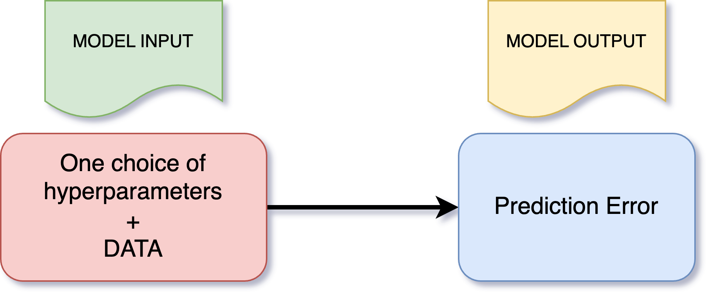
Motivation
We consider the fact that almost all models in Machine Learning require specific hyperparameters:

Slide 3
Main Idea
Why aren't we testing all possible choices/values for the hyperparameters?
Why not just use gradient descent to determine the best choice of hyperparameters?
FACT: We may rarely be able to compute in closed form gradients of the prediction error with respect to the hyperparameters
SOLUTION:
Subdivide the ranges of hyperparameters in grids (if they are numerical, equally spaced values)
Initialize the hyperparameters with a random choice
Evaluate the prediction error with this choice
Update the hyperparameters with a procedure that includes good heuristics
Test the new choice
Repeat the previously two steps until there is no more distinguishable progress relative to a tolerance value.

Slide 4
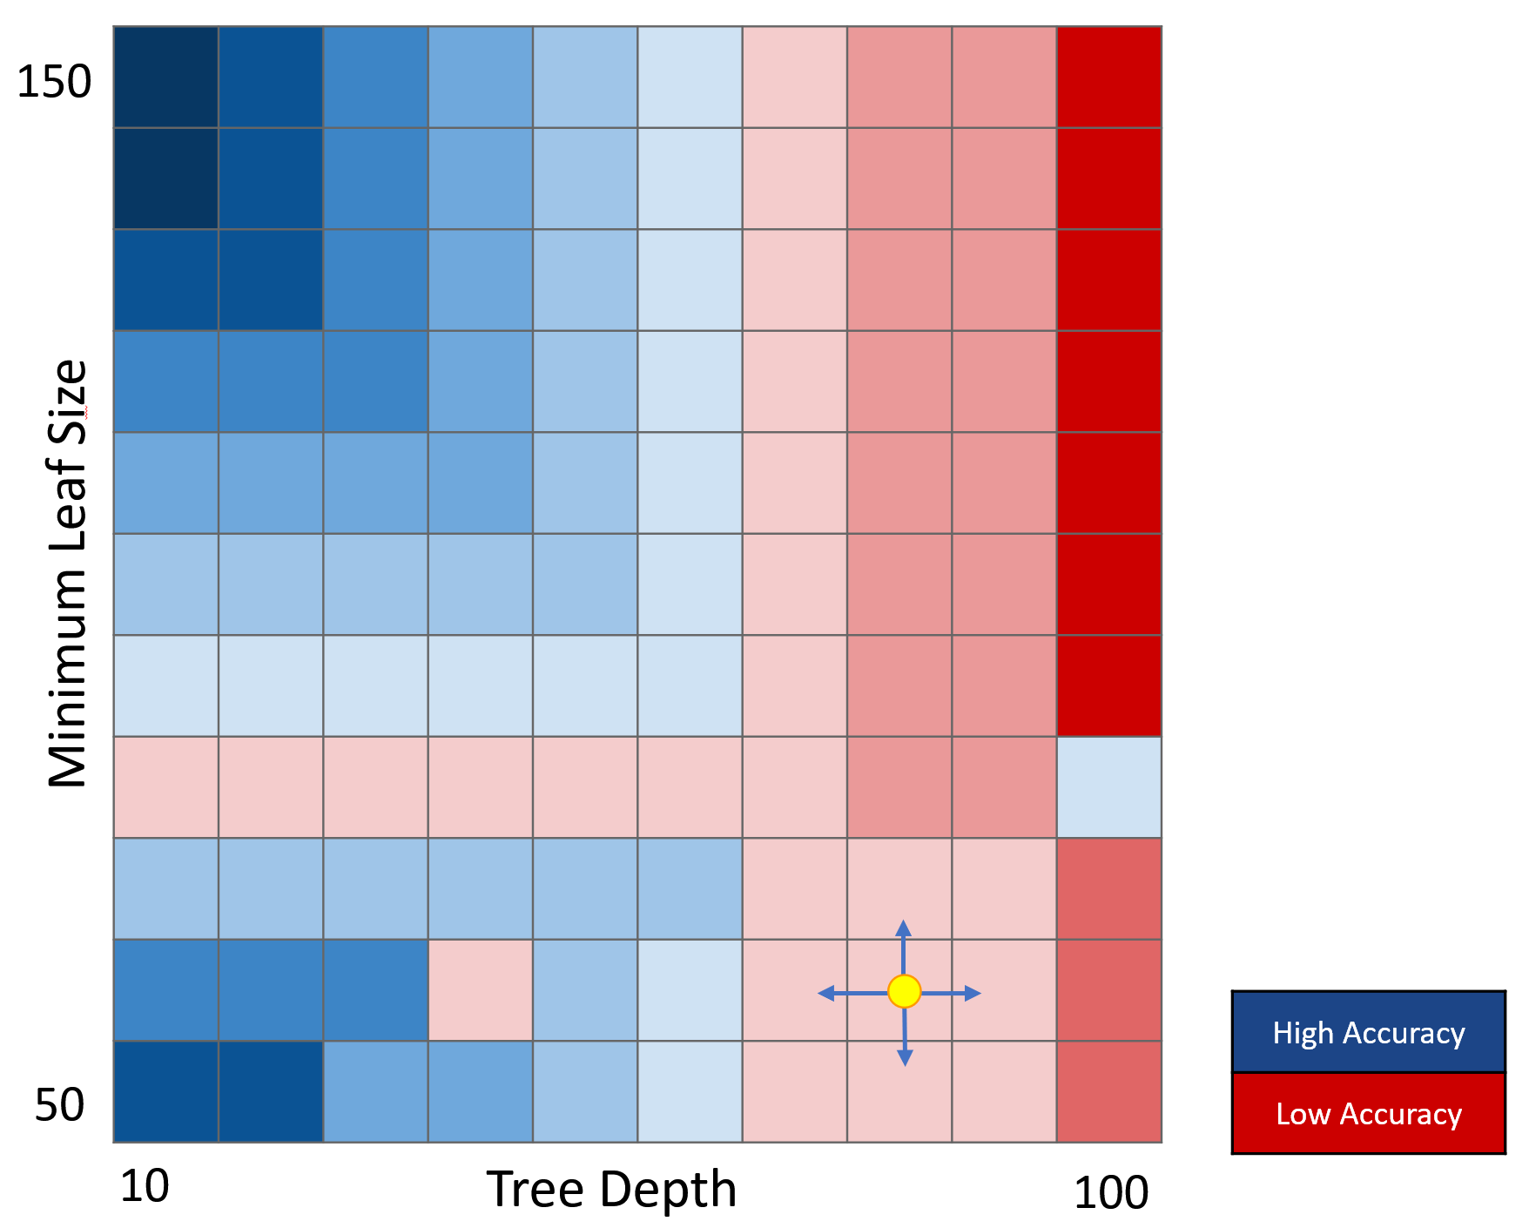
Grid Example
Assume that we want to determine the best tree depth and the best leaf size for a classification tree. The following image color-codes the values of the cost function based on the grid values.

Slide 5
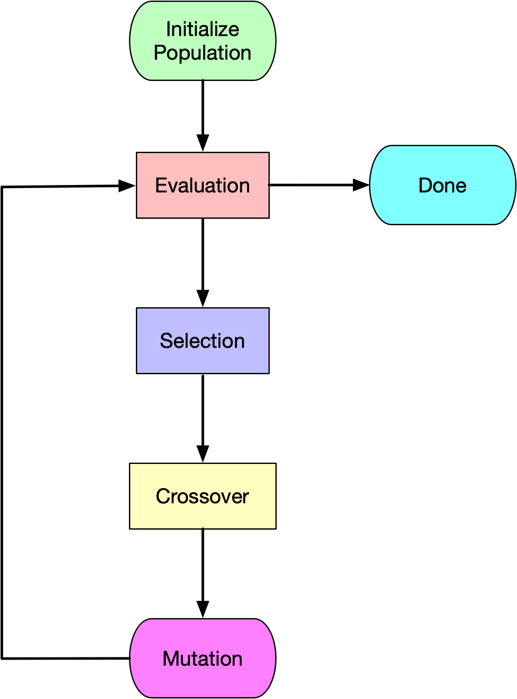
Genetic Algorithms

Slide 6
Steps in Genetic Algorithms
Evaluation
We compute the value of the output at each individual form the population and we ranked the individuals.
Selection
In order to create a parent we draw a random subset from the population and pick the most "fit" individual. Once we obtain two parents we can applying the crossover and mutation procedures for generating children.

Slide 7
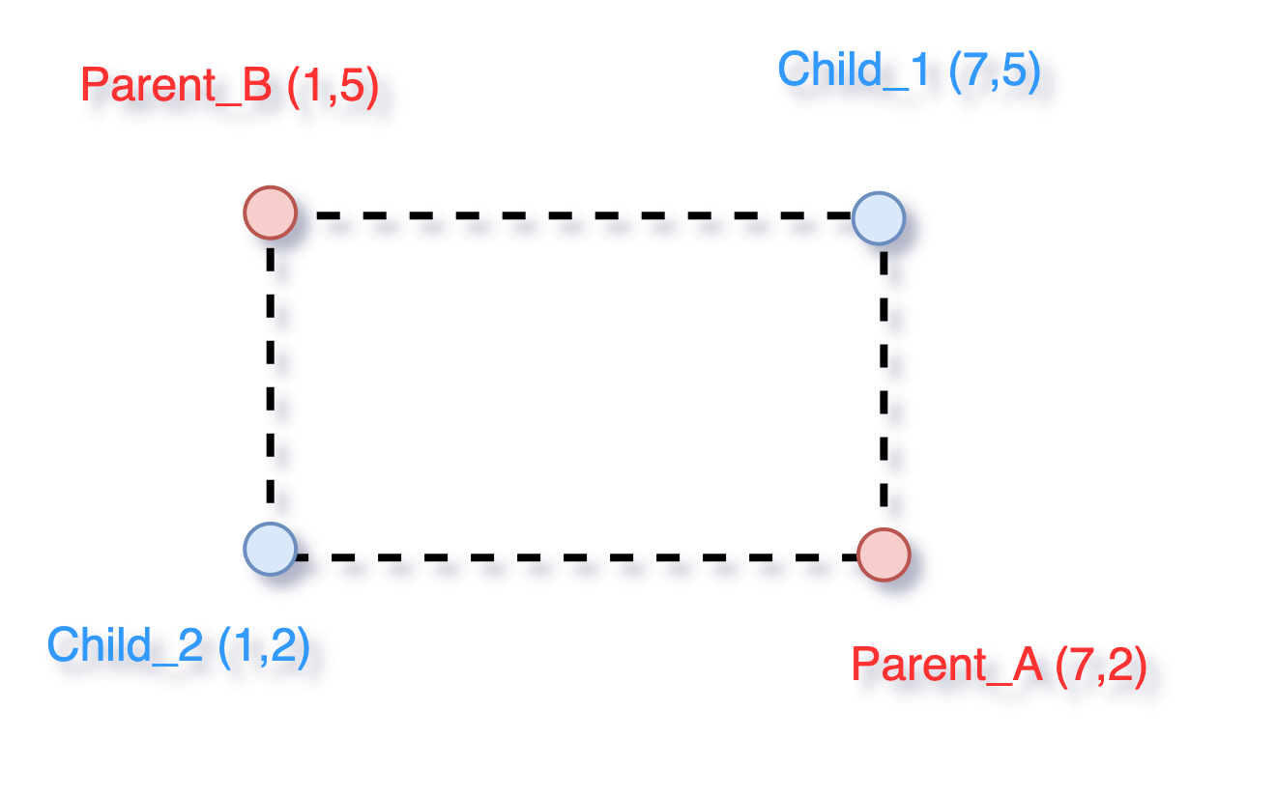
Crossover
Typically we implement a two-point crossover. If the grid is 2-D we consider a crossover procedure illustrated below:

Slide 8
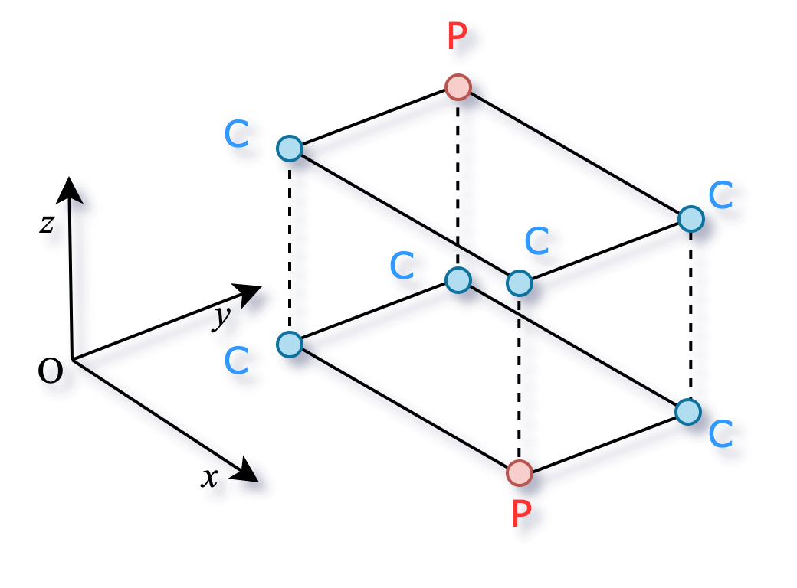
Crossover
In 3-D a two-point crossover can be implemented as follows:
(2,5,4)
(7,2,1)

Slide 9
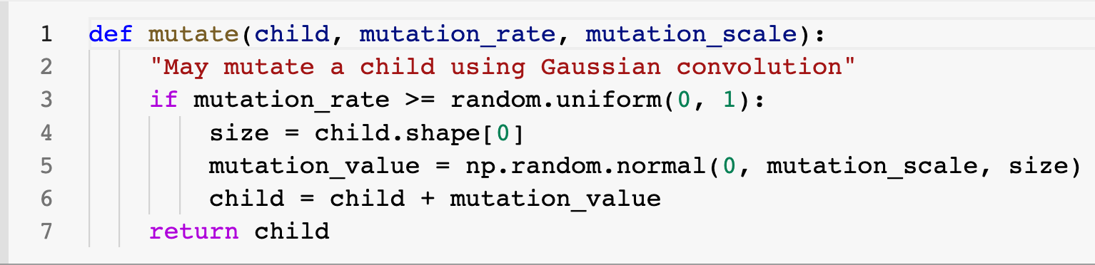
Mutation
We implement the mutation as a perturbation with values sampled from a random normal variable of mean 0 and standard deviation equal to the desired "mutation scale."

Slide 10
Example of Visualization
References:
http://cobweb.cs.uga.edu/~potter/CompIntell/ga_tutorial.pdf
https://www.scottcondron.com/jupyter/optimisation/visualisation/2020/07/20/interactive-genetic-algorithm-dashboard-from-scratch-in-python.html
https://mitpress.mit.edu/9780262631853/an-introduction-to-genetic-algorithms/
Fun video to watch:
https://www.youtube.com/watch?v=FKbarpAlBkw

Slide 11
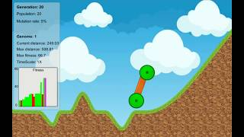
Example of Visualization

Slide 12
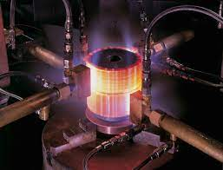
Simulated Annealing
Annealing is a concept from material science; it refers to heating metal or glass and allow it to cool slowly, in order to remove internal stresses and make it easier to work.

Slide 13
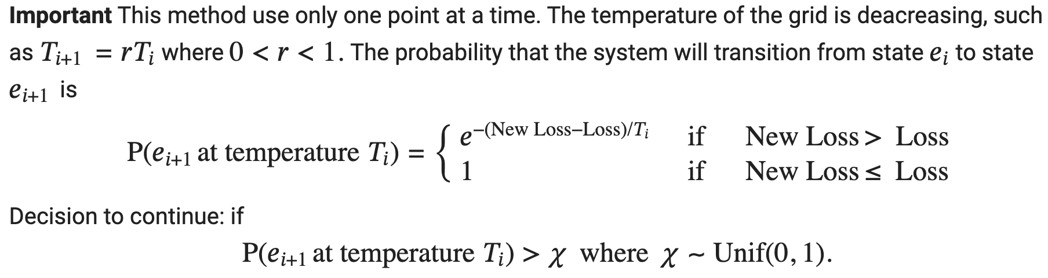
Simulated Annealing
Main Idea: drop a random trial point and then, based on the value of the objective function, continue to drop other points at a certain distance. The distance between consecutive points is measured as a function of the "temperature" which is decreasing based on an exponential law.

Slide 14
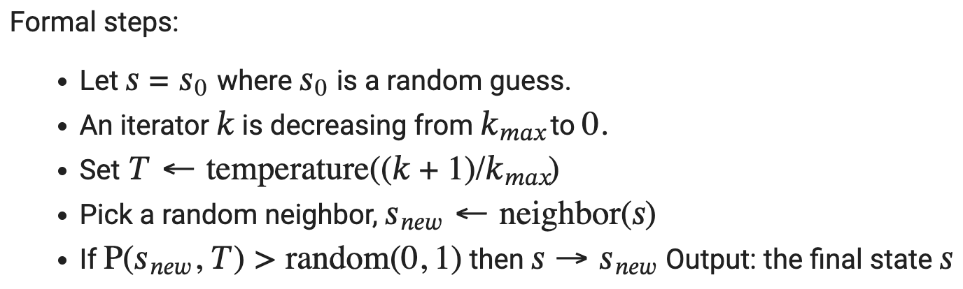
Implementation
Visual example for simulated annealing algorithm: https://www.youtube.com/watch?v=iaq_Fpr4KZc

Slide 15
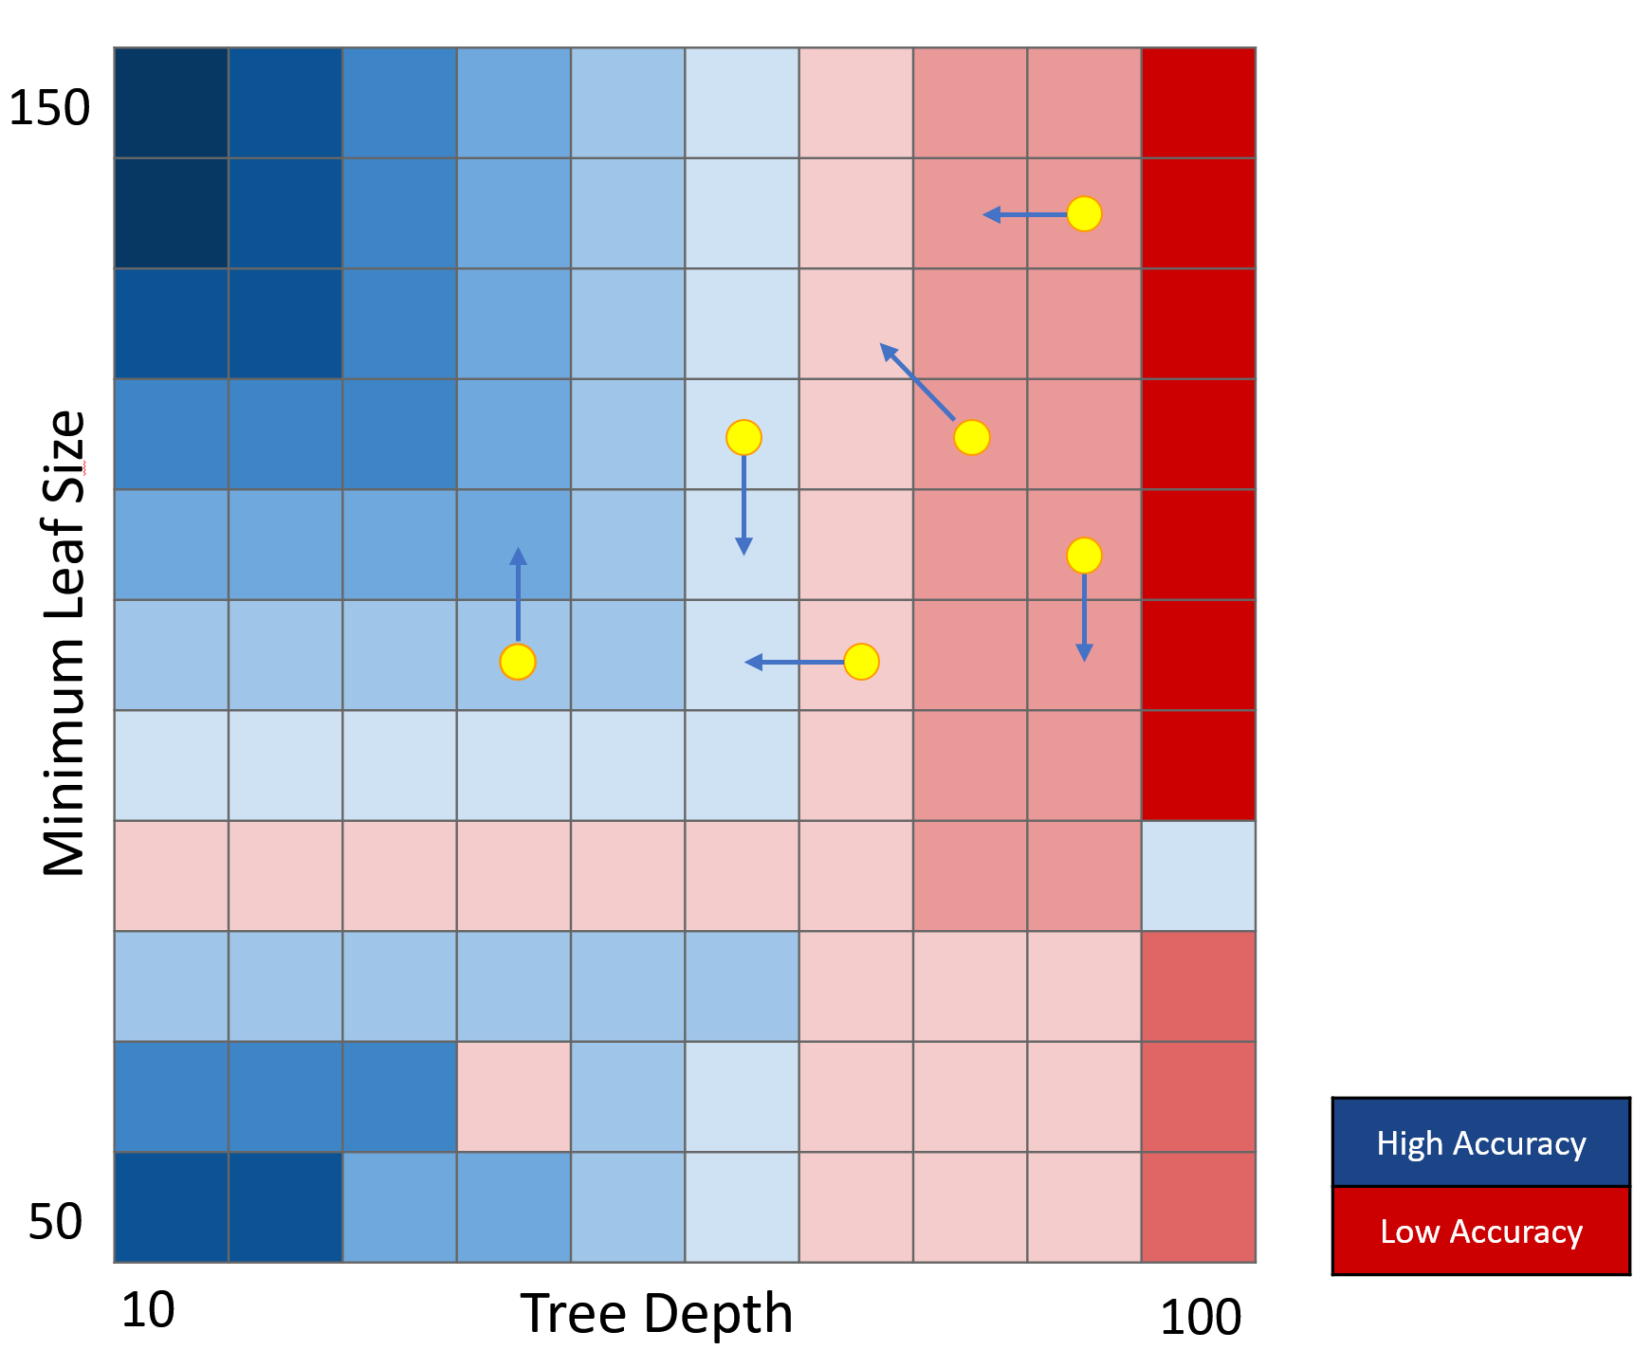
Swarm Algorithms
Main Idea: consider a collection of particles that move around the search space influenced by their own best past location and the best past location of the whole swarm or a close neighbor.

Slide 16
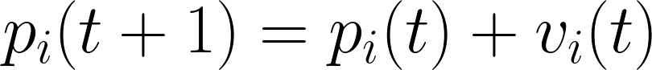
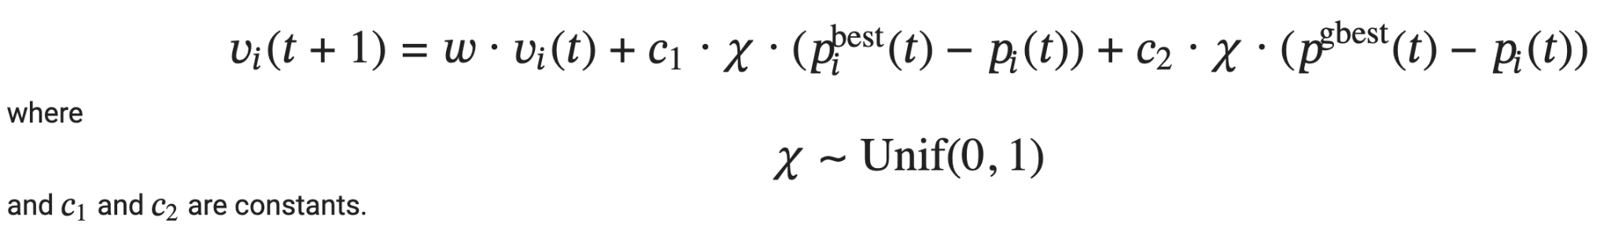
Implementation
The particle positions get updated by using velocities:
To get velocities we implement the following:

Slide 17
Heuristics
The number of particles should be low, around 10 - 40.
The speed a particle can move (maximum change in its position per iteration) should be bounded, such as to a percentage of the size of the domain.
The learning factors (biases towards global and personal best positions) should be between 0 and 4, typically 2.
A local bias (local neighborhood) factor can be introduced where neighbors are determined based on Euclidean distance between particle positions.
Particles may leave the boundary of the problem space and may be penalized, be reflected back into the domain or biased to return back toward a position in the problem domain. Alternatively, a wrapping strategy may be used at the edge of the domain creating a loop, torrid or related geometrical structures at the chosen dimensionality.

Slide 18
Example of Visualization

Slide 19
Example of Visualization

Slide 20
Lévy Flights
Algorithm:
Initialize parameters (n, pa, λ and α);
Generate initial population of n host nests xi;
While (t <MaxGeneration) or (stop criterion) do
Get a cuckoo randomly;
Generate a solution by Lévy flights;
Evaluate its solution quality or objective value;
Choose a nest among n (say, j) randomly;
if (fi < fj ) then
Replace j by the new solution i;
A fraction (pa) of worse nests are abandoned;
New nests/solutions are built/generated;
Keep best solutions (or nests with quality solutions);
Rank the solutions and find the current best solution;
Update t ← t + 1;
Reference: https://www.researchgate.net/publication/340540368_Cuckoo_Search_Algorithm_An_Introduction

Slide 21
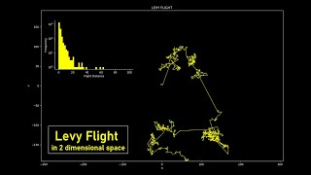
Lévy Flights

